Slide 1
FCI Level-2 Products from the EUMETSAT Central Facility
Johan Strandgren with contributions from
Youva Aoun, Regis Borde, Alessio Bozzo, Alessandro Burini, Manuel Carranza, Greg Dew, John Jackson, Hans-Joachim Lutz, Andrea Meraner, Olivier Samain, Loredana Spezzi
EUMeTrain MTG Event Week | June 24, 2025 | Online
Contact: Johan.Strandgren@eumetsat.int

Slide 2
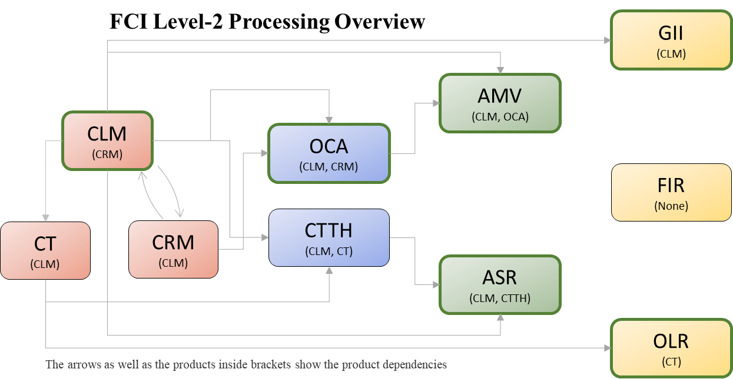
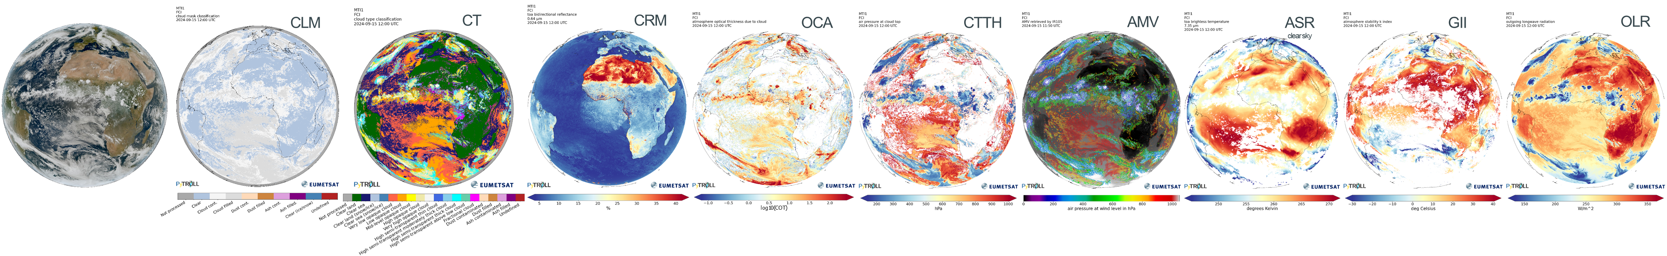
EUMETSAT Central Facility FCI L2 products
A total of 10 products
Day-1 priority: ensure SEVIRI continuity → FCI’s full potential not yet fully exploited
Only normal resolution (FDHSI) data at 1km (VIS/NIR) and 2km (IR)
New VIS/NIR channels are generally not used yet
Commissioning of the FCI L2 products continue after MTG-I1 and FCI L1C were declared operational in December 2024 and MTG as prime GEO satellite in June 2025
First six products released in December 2024. Further releases and upgrades in 2025.
Additional FCI L2 products will be available via the Satellite Application Facilitates (SAFs)

Slide 3
Cloud Detection, Classification and Properties Retrieval

Slide 4
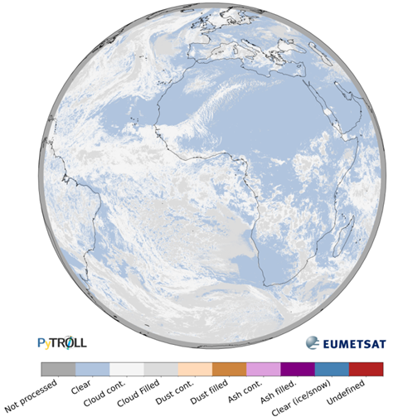
Cloud Mask (CLM)
Detection of clouds, dust, ash and cloud-free ice/snow
Based on the NWC-SAF cloud mask (CMA) algorithm
Includes a total of 25 spectral tests with both static and dynamic (scene dependent) thresholds
Used as input for most of the other L2 products
Released with pre-operational status in December 2024
cloud state
Spatial resolution | Periodicity | File format | Access
2×2 km² (at nadir) | 10 min | NetCDF, GRIB2 | EUMETCast, Data Store

Slide 5
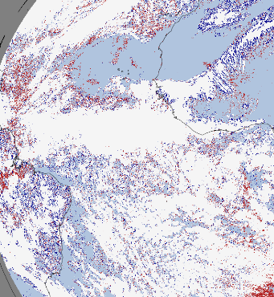
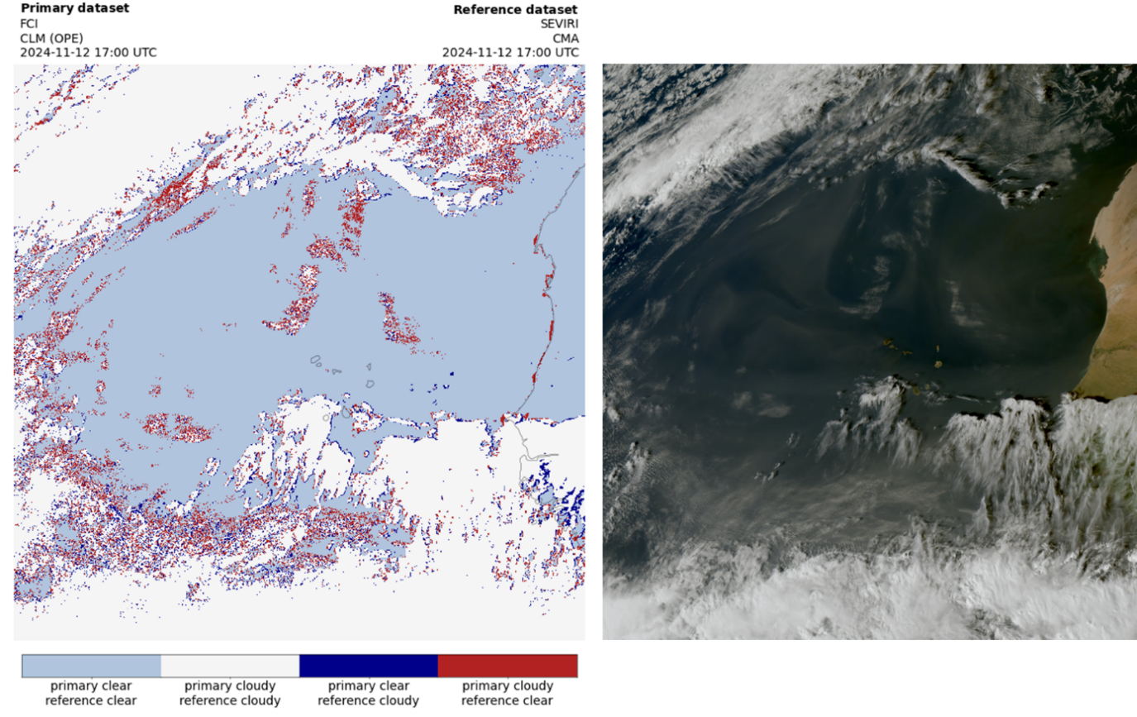
CLM Early validation results
Improved detection of small-scale clouds wrt. SEVIRI NWC-SAF thanks to better spatial resolution of FCI

Slide 6
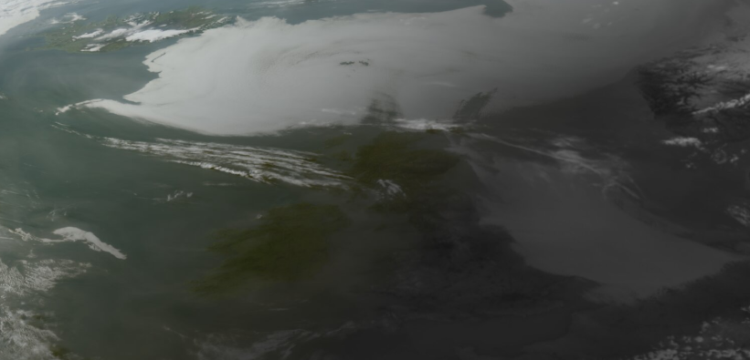
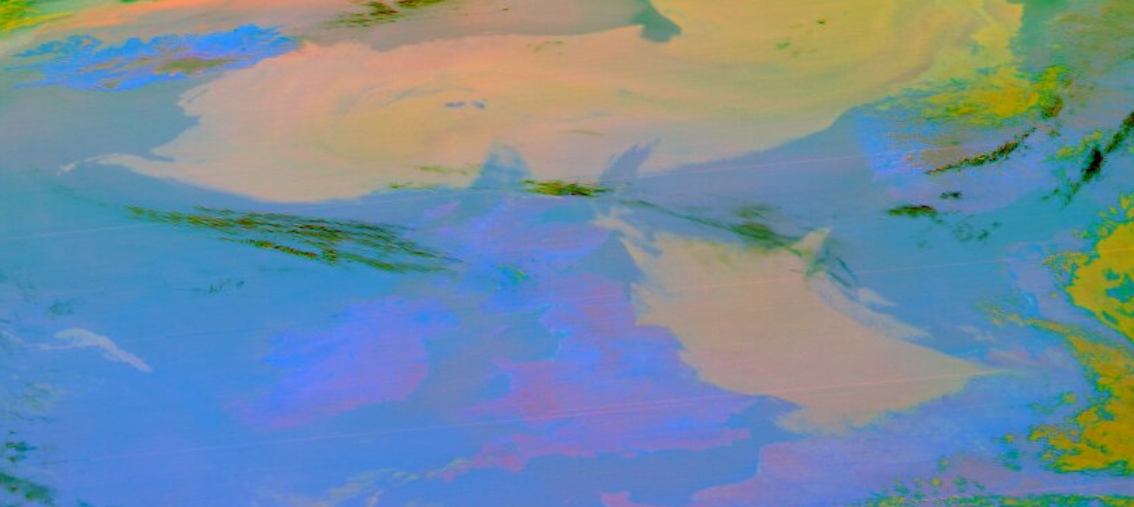
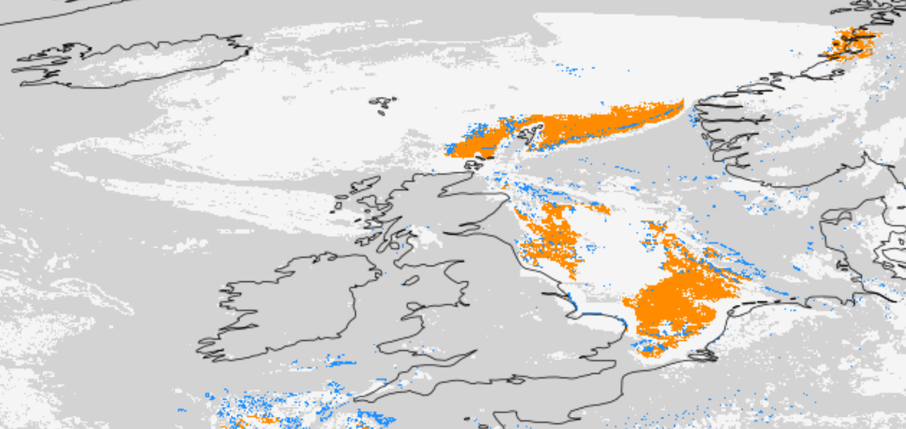
CLM Upcoming improvements in the pipeline
Several remaining anomalies have been resolved during spring 2025 and are currently being finalized:
Update of static data files (surface type, distance to coast and BRF LUT) using recent VIIRS IGBP surface classification data.
Low-cloud restoral at twilight including spatial expansion for improved twilight fog detection where IR3.8 signal becomes ambiguous. Tuning ongoing
Improved daytime detection of fractional/small cumulus cloud over land
Removal of coastal false alarms and “noise” pixels
Further fine tuning of all tests to optimize POD and FAR.
Improved processing stability
Target is to deploy these improvements and release CLM with operational status in 2025/Q3.
Detection of snow/ice, dust and ash and further improvements out outstanding issues to come later.
L1C True Color RGB with IR.5 at night
L1C DustRGB
L2 CLM restoral of low clouds at twilight – preliminary results
Clear | Cloudy | Cloud restored by temporal consistency test | Cloud restored by spatial expansion

Slide 7
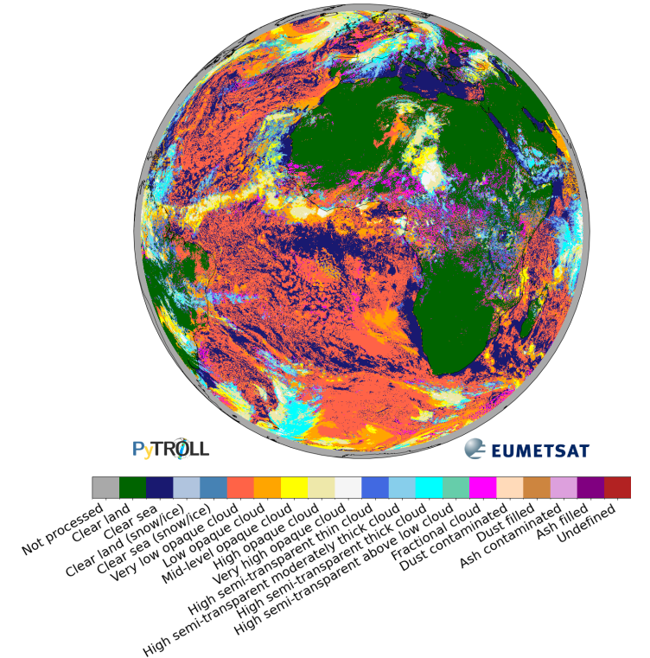
Cloud Type and Phase (CT)
Cloud type
Classification of clouds based on type, phase and height
Based on the NWC-SAF CT and CMIC algorithms
Includes several spectral tests with both static and dynamic (scene dependent) thresholds
Fine tuning of thresholds is ongoing (with support from NWC-SAF) to improve the classification, especially for very low opaque, fractional and thin semi-transparent clouds.
Target is to deploy these improvements and release CT with pre-operational status in 2025/Q3 and operational status in 2025/Q4
Spatial resolution | Periodicity | File format | Access
2×2 km² (at nadir) | 10 min | NetCDF | EUMETCast, Data Store

Slide 8
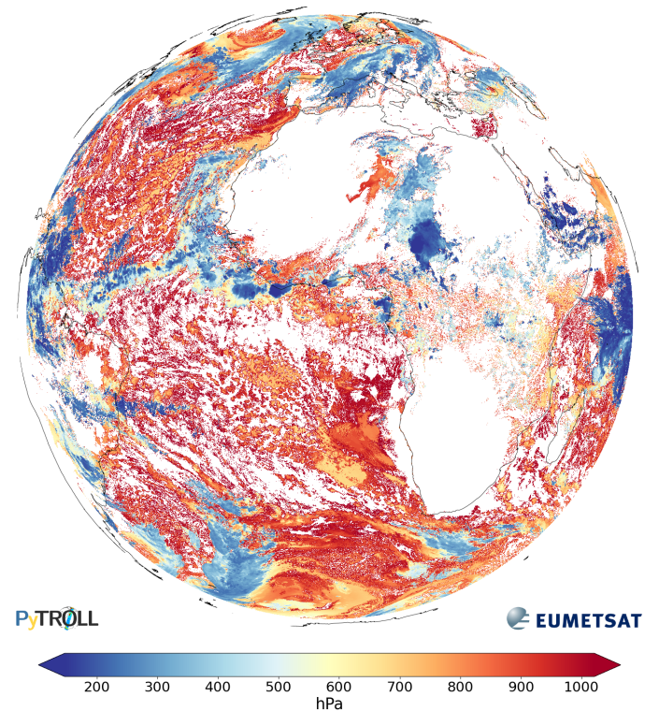
Cloud Top Temperature and Height (CTTH)
Cloud Top Pressure
Retrieval of cloud top pressure (hPa), temperature (K) and height (m)
Based on the NWC-SAF CTTH algorithms
Optimization of heigh retrieval in case of low thermal inversion ongoing.
Retrieval scheme depends on the cloud type → CTTH relies on accurate cloud type classification of the CT product.
Target is to deploy these improvements and release CTTH with pre-operational status in 2025/Q3 and operational status in 2025/Q4
Spatial resolution | Periodicity | File format | Access
2×2 km² (at nadir) | 10 min | NetCDF | EUMETCast, Data Store

Slide 9
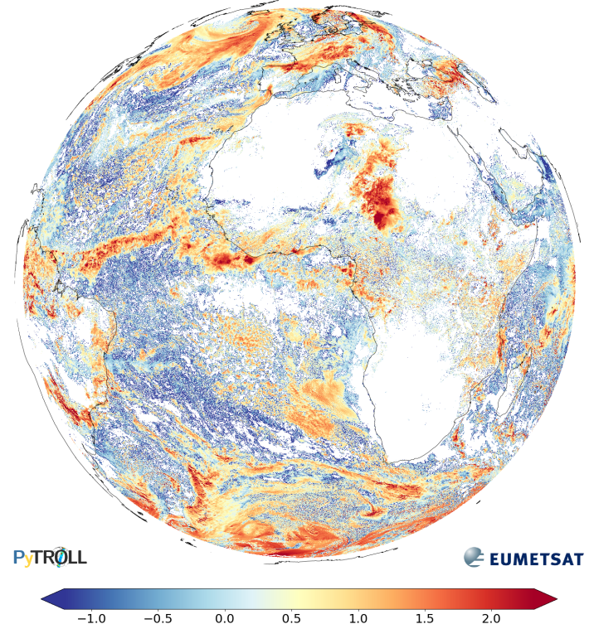
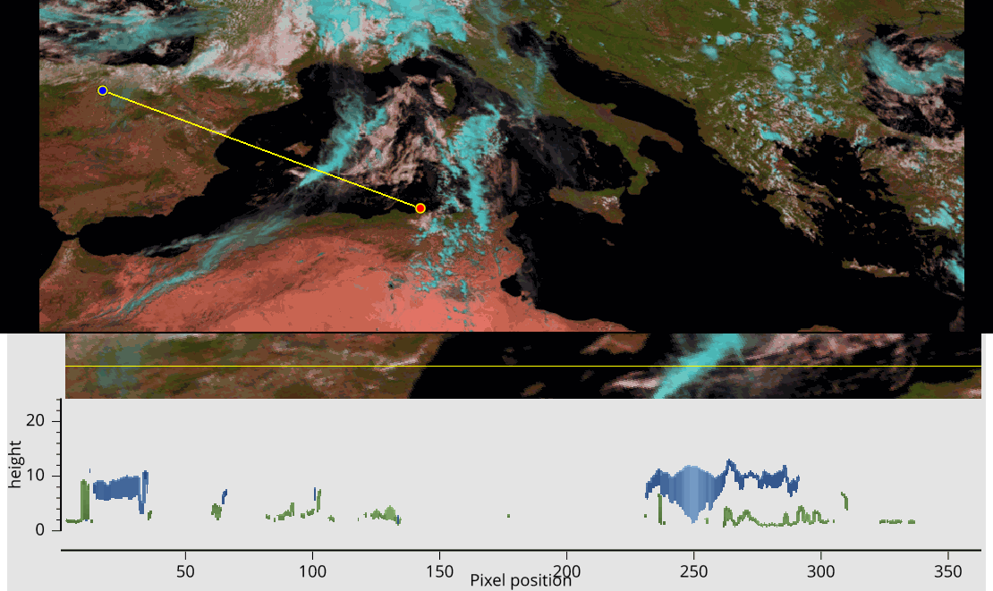
Optimal Cloud Analysis (OCA)
Cloud optical thickness (log10)
1DVar inversion of VIS+IR imagery measurements (Watts et al. 2011):
Retrieves height and optical properties of clouds:
Solution ‘Cost’ + linear error estimate
Multi-mission algorithm for GEO and LEO optical imagers. SEVIRI, FCI, METimage
Supports two-layer cloud retrievals
Released with pre-operational status in December 2024
Spatial resolution | Periodicity | File format | Access
2×2 km² (at nadir) | 10 min | NetCDF | EUMETCast, Data Store

Slide 10
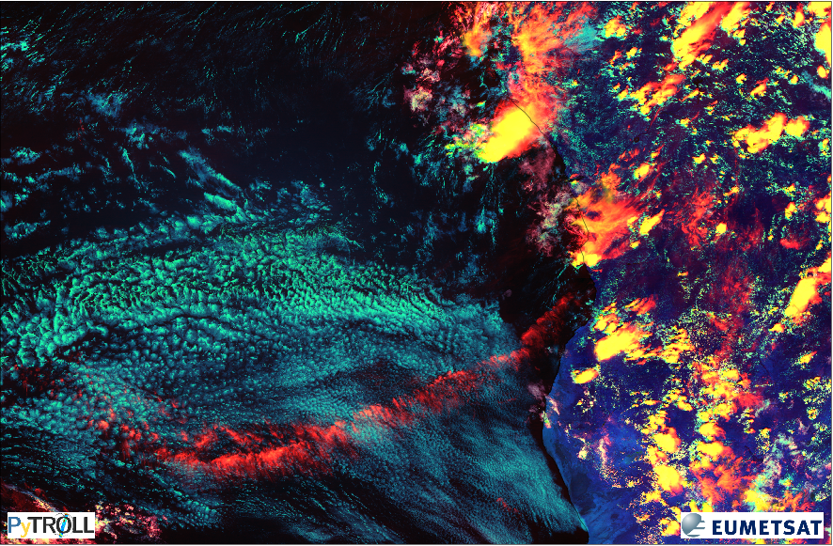
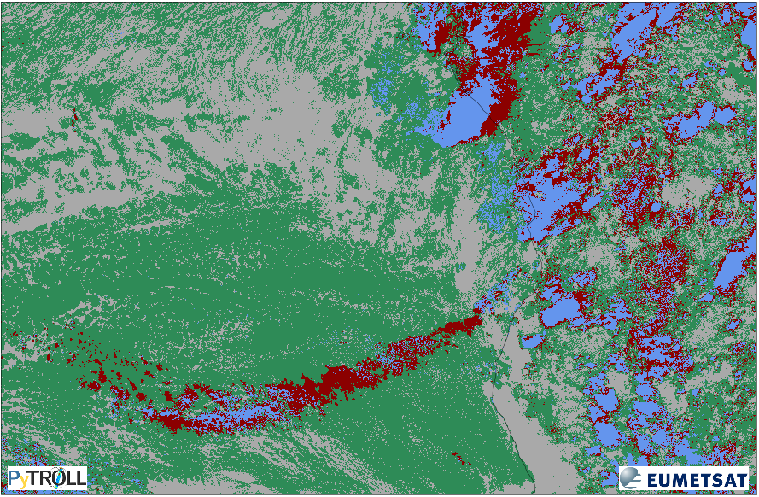
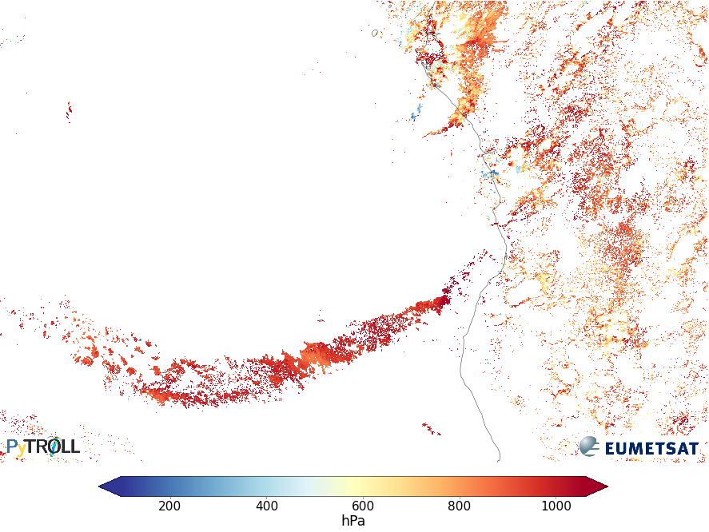
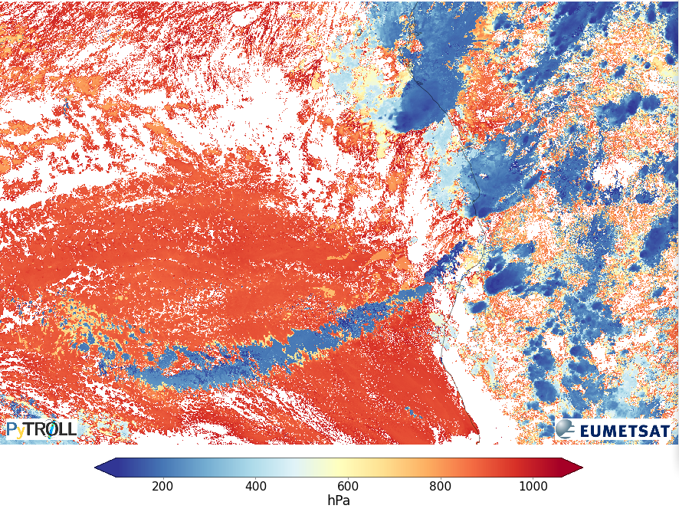
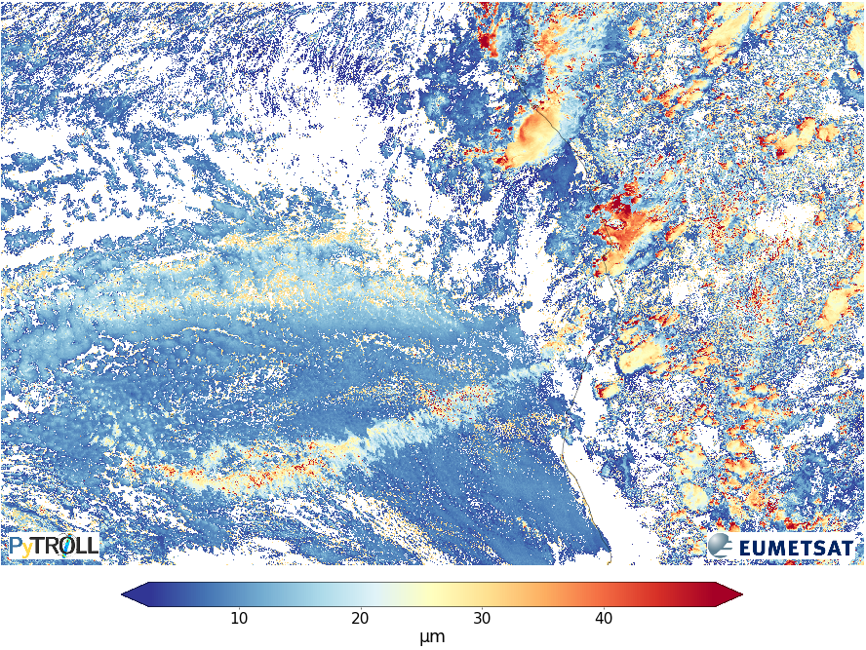
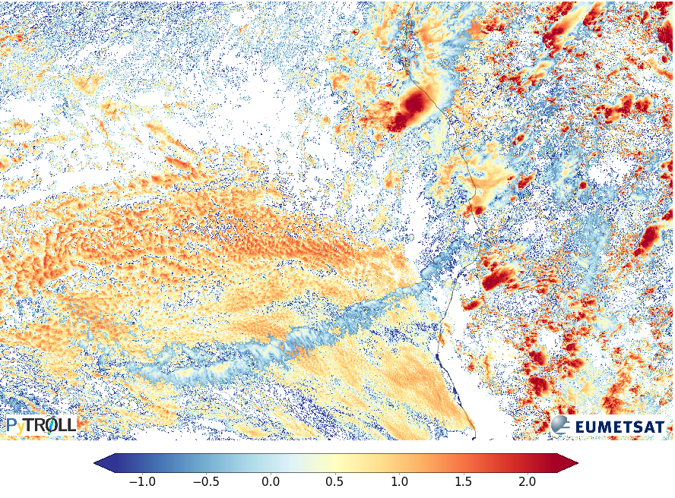
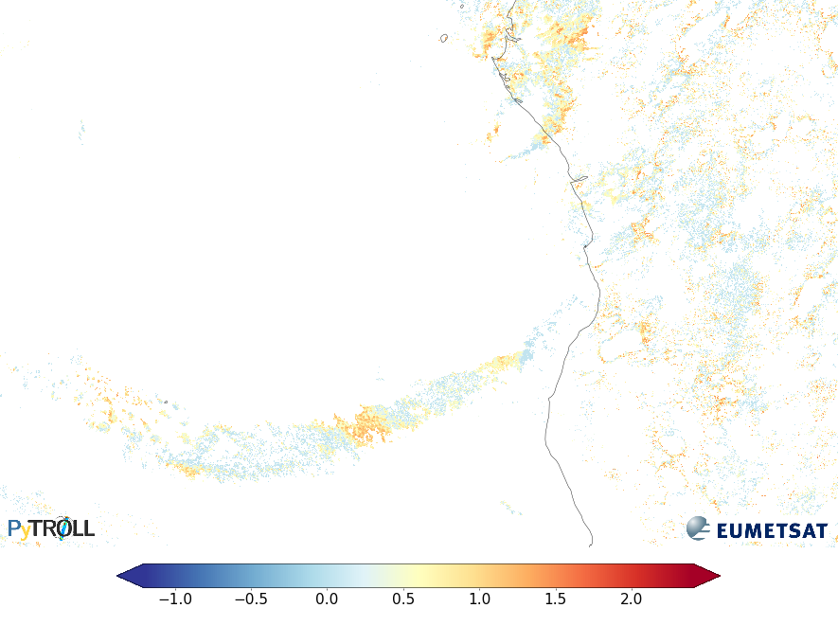
OCA datasets
Cloud phase
Cloud top (pressure, height, temperature)
Lower layer
Cloud effective radius
Cloud optical thickness
Lower layer
Microphysics only available for upper layer
Two-layer retrieval quality depends on the relative optical thickness of the overlapping layers

Slide 11
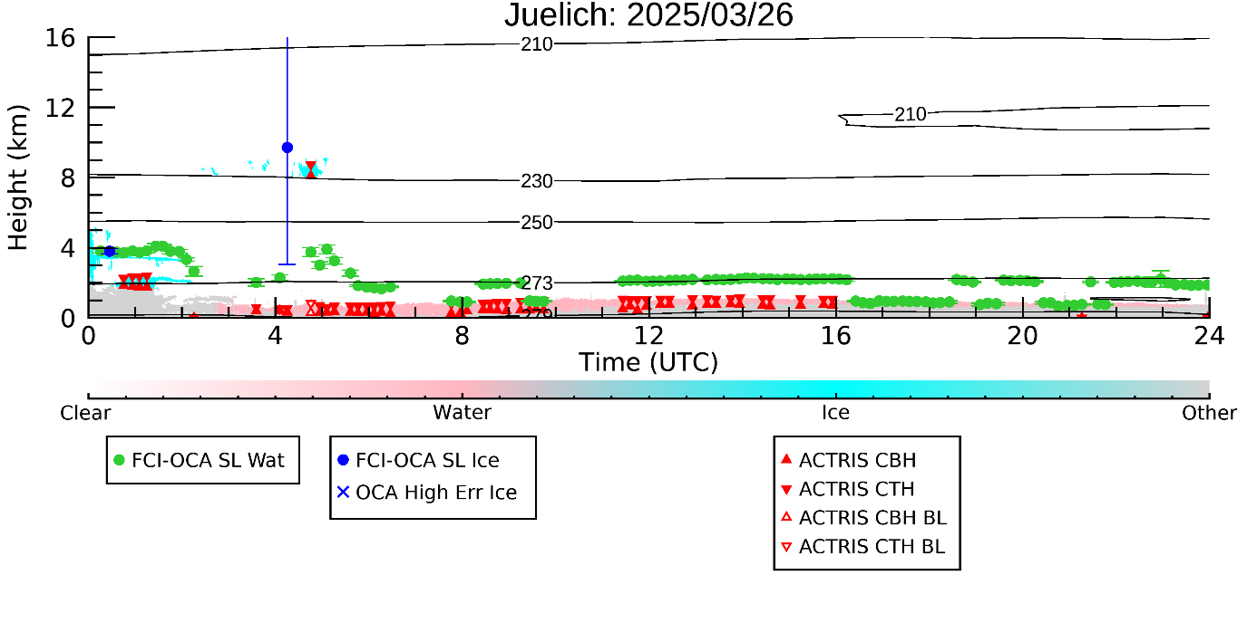
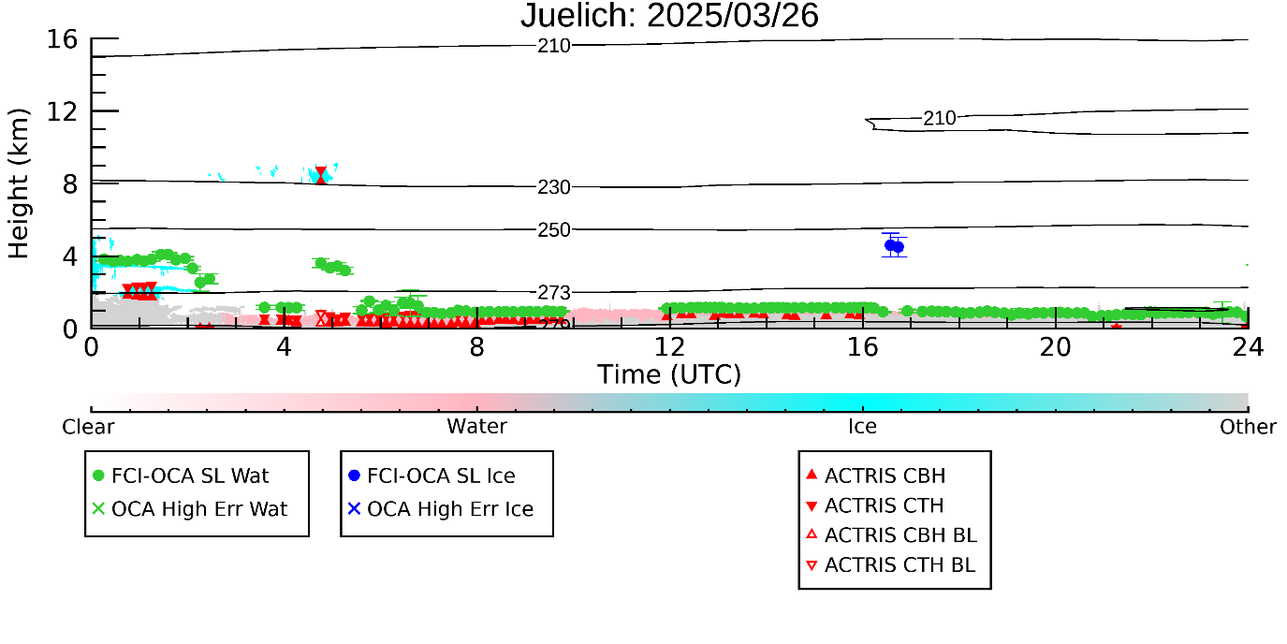
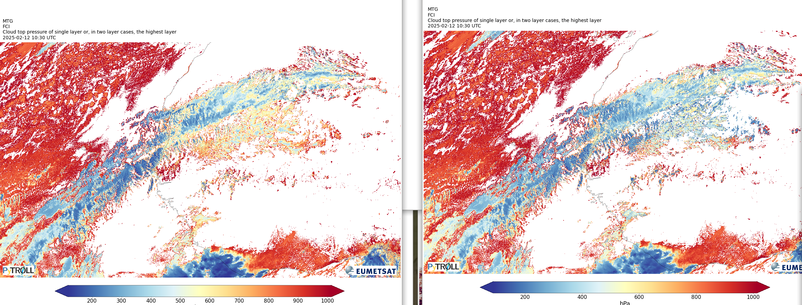
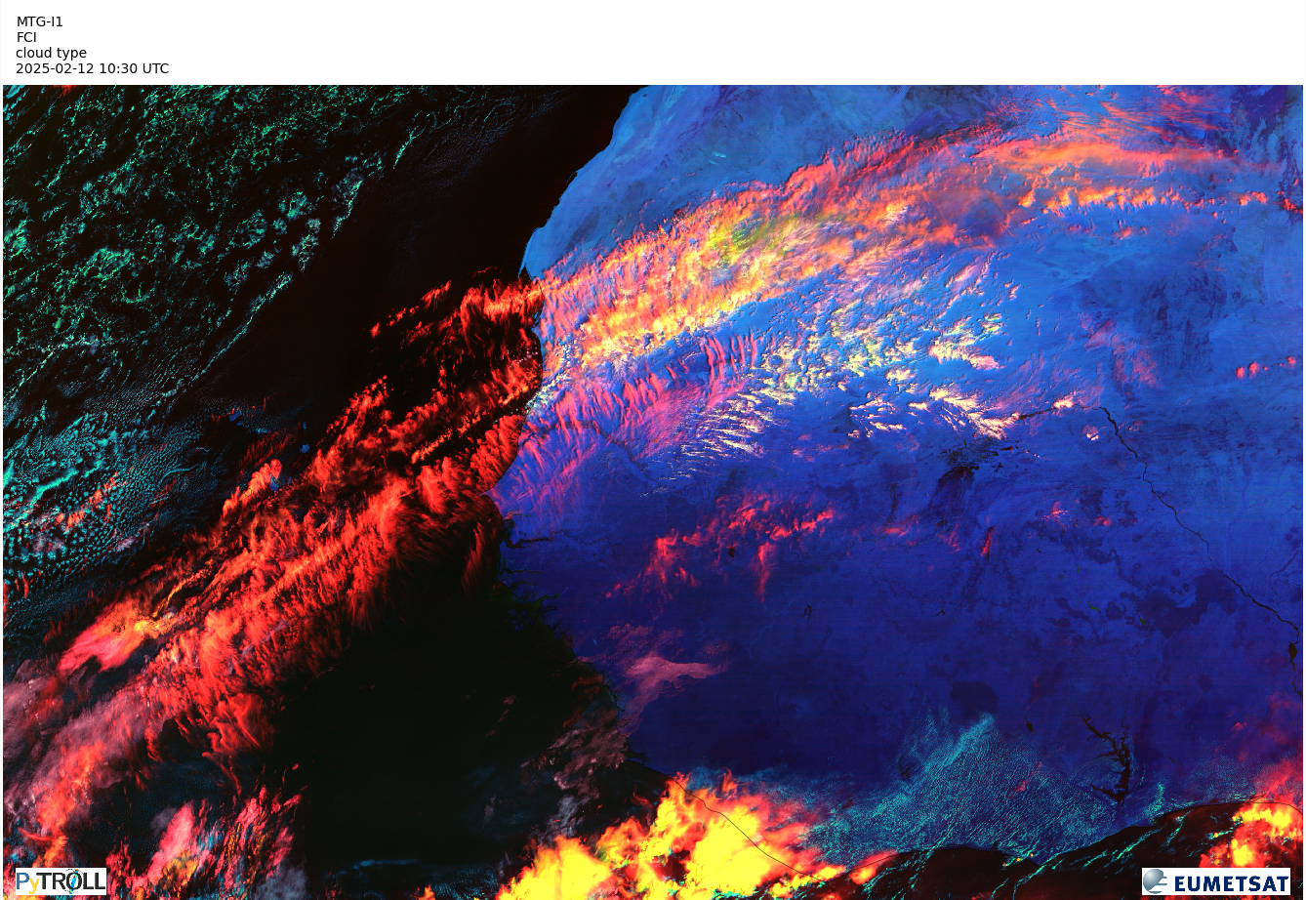
OCA Upcoming improvements in the pipeline
Bug fixes and improvements
Improved low clouds CTH (implemented in April)
Improved thin high clouds/contrails CTH (in testing)
Adjusted measurements error covariance
Updated thresholds for first-guess parameters
Target is to release OCA with operational status in 2025/Q3.

Slide 12
Clear-Sky Products

Slide 13
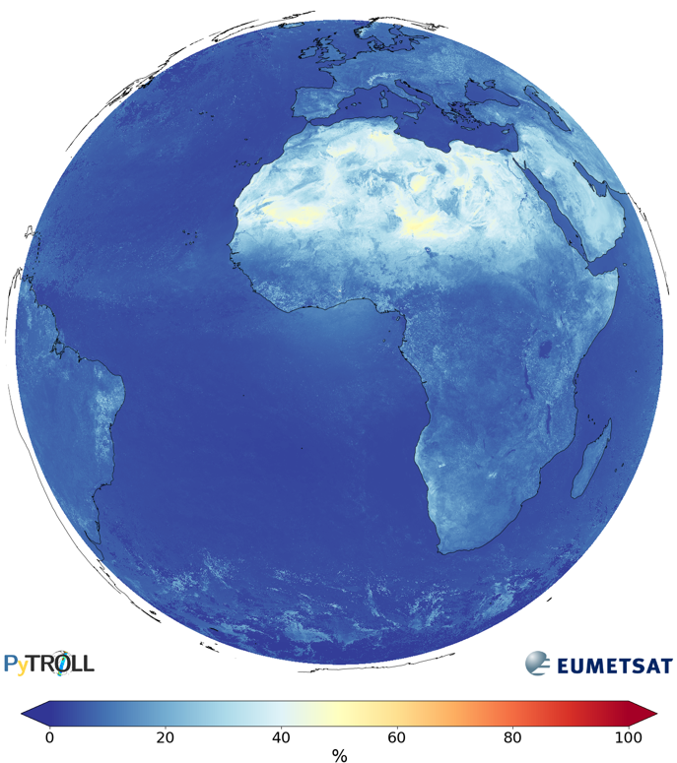
Clear-sky Reflectance Map (CRM)
Clear-sky reflectance for VIS0.6 channel
Temporal average (7-14 days) of FCI VIS/NIR data for cloud free scenes
Describes the reflection that would be registered by the FCI VIS/NIR channels in cloud free conditions, using the actual satellite position and including (possible) atmospheric effects. Hence, no (atmospheric) corrections are applied to the data
Should not be uses as an albedo product, but rather for constraining other retrievals using the FCI VIS/NIR L1C data
Consistently cloudy scenes are padded with climatology data depending in channel, surface type and sun-satellite viewing geometry
Pixels padded with climatology should be treated with care since the climatology can be (significantly) inaccurate, especially for channels sensitive to atmospheric effects like scattering and absorption
Remaining issues and expected improvements over the next 1-2 months:
Reduced cloud contamination through cloud mask improvements and fine tuning
Improved processing stability. Fewer missing/partial products and no/limited impact in case of processing facility restarts
CRM released to member state NHMSs with pre-operational status on June 17, 2025. Release to all users on July 3, 2025. Target is to deploy the further improvements and release CRM with operational status in 2025/Q3
Spatial resolution | Periodicity | File format | Access
1×1 km² (at nadir) | 2h, between 04:00 and 20:00 | NetCDF | EUMETCast, Data Store

Slide 14
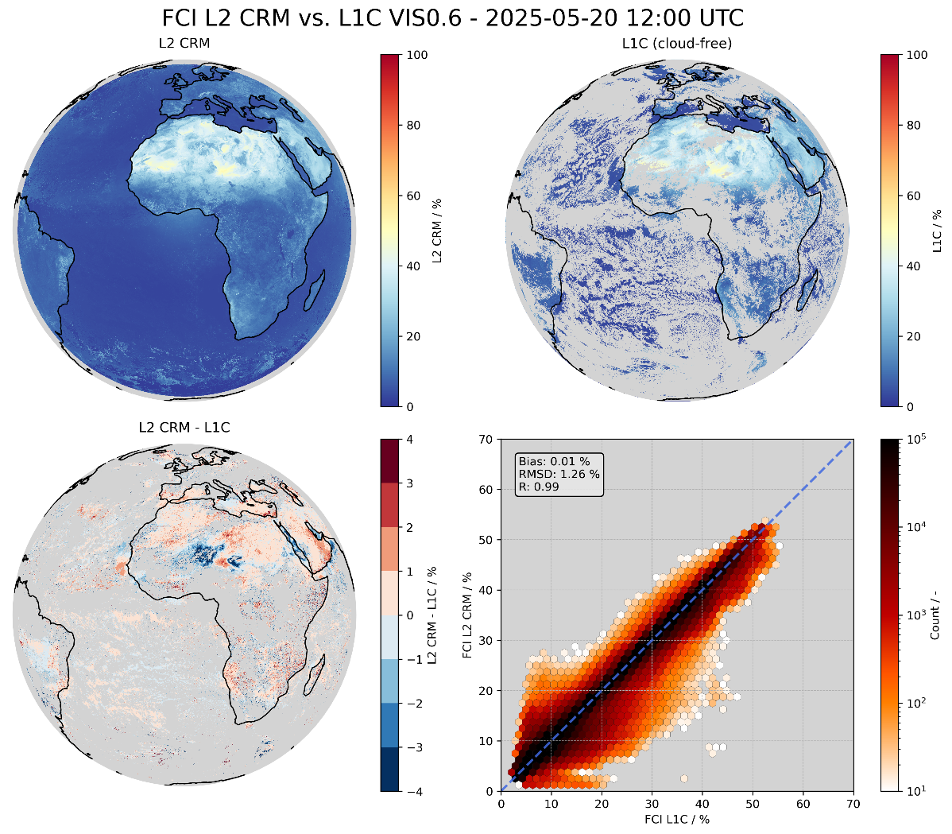
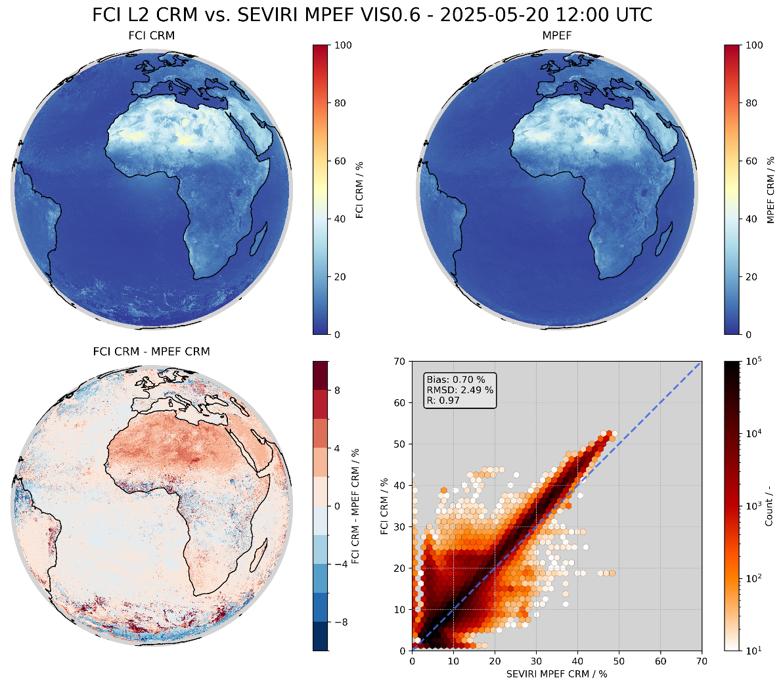
CRM Early validation results for pre-operational release
Generally good agreement with L1C and MSG-SEVIRI CRM data, but:
Some cloud contamination cause too high CRM values – Should improve with CLM anomaly fixes and fine tuning prepared for operational release
Climatology values sometimes clearly different compared to real values – some improvements planned, but largely a limitation of the methodology
Verification against target L1C data (sanity check)
Verification against MSG SEVIRI CRM data
Bias between FCI and SEVIRI for VIS/NIR channels is a known issue independent of CRM

Slide 15
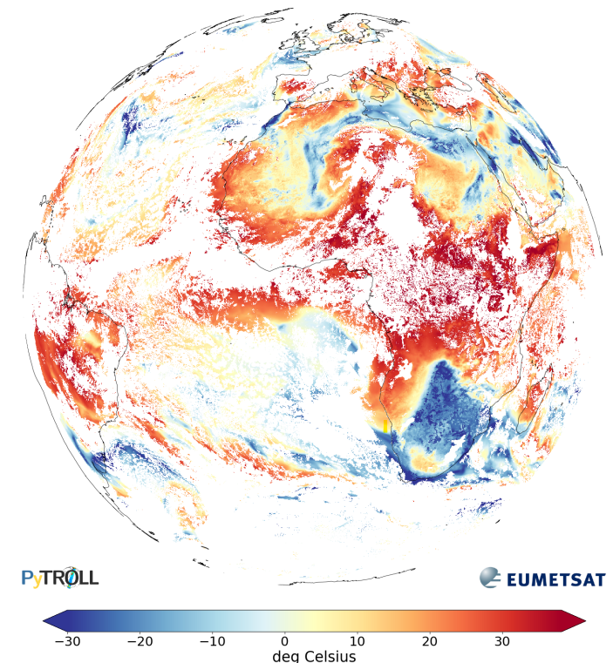
Global Instability Indices (GII)
Retrieval of k-index, lifted index and total column water vapour (TCWV) for clear-sky scenes
Optimal estimation approach that fits forecast temperature and humidity profiles to the FCI IR observations → available both at day and night
Instability indices and integrated total column water vapour amount derived from the modified temperature and humidity profiles.
Strongly tied to the a-priory forecast but can help extract more spatial and temporal detail
Released with pre-operational status in December 2024. Target is to release GII with operational status in 2025/Q3 following operational quality of the cloud mask.
k-index
Spatial resolution | Periodicity | File format | Access
6×6 km² (at nadir) | 10 min | NetCDF | EUMETCast, Data Store

Slide 16
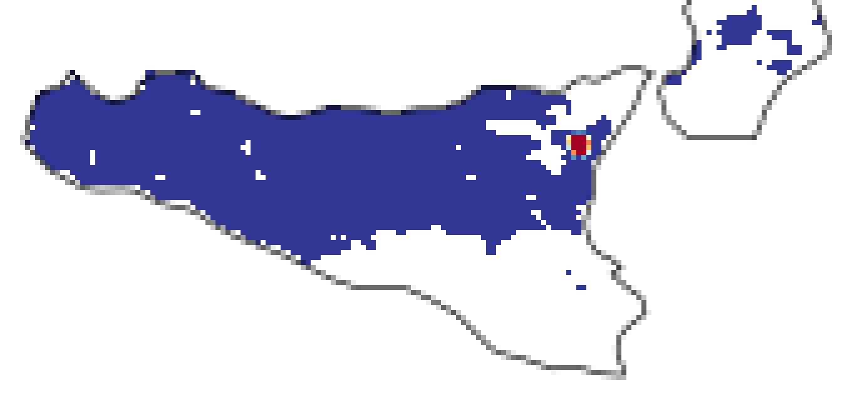
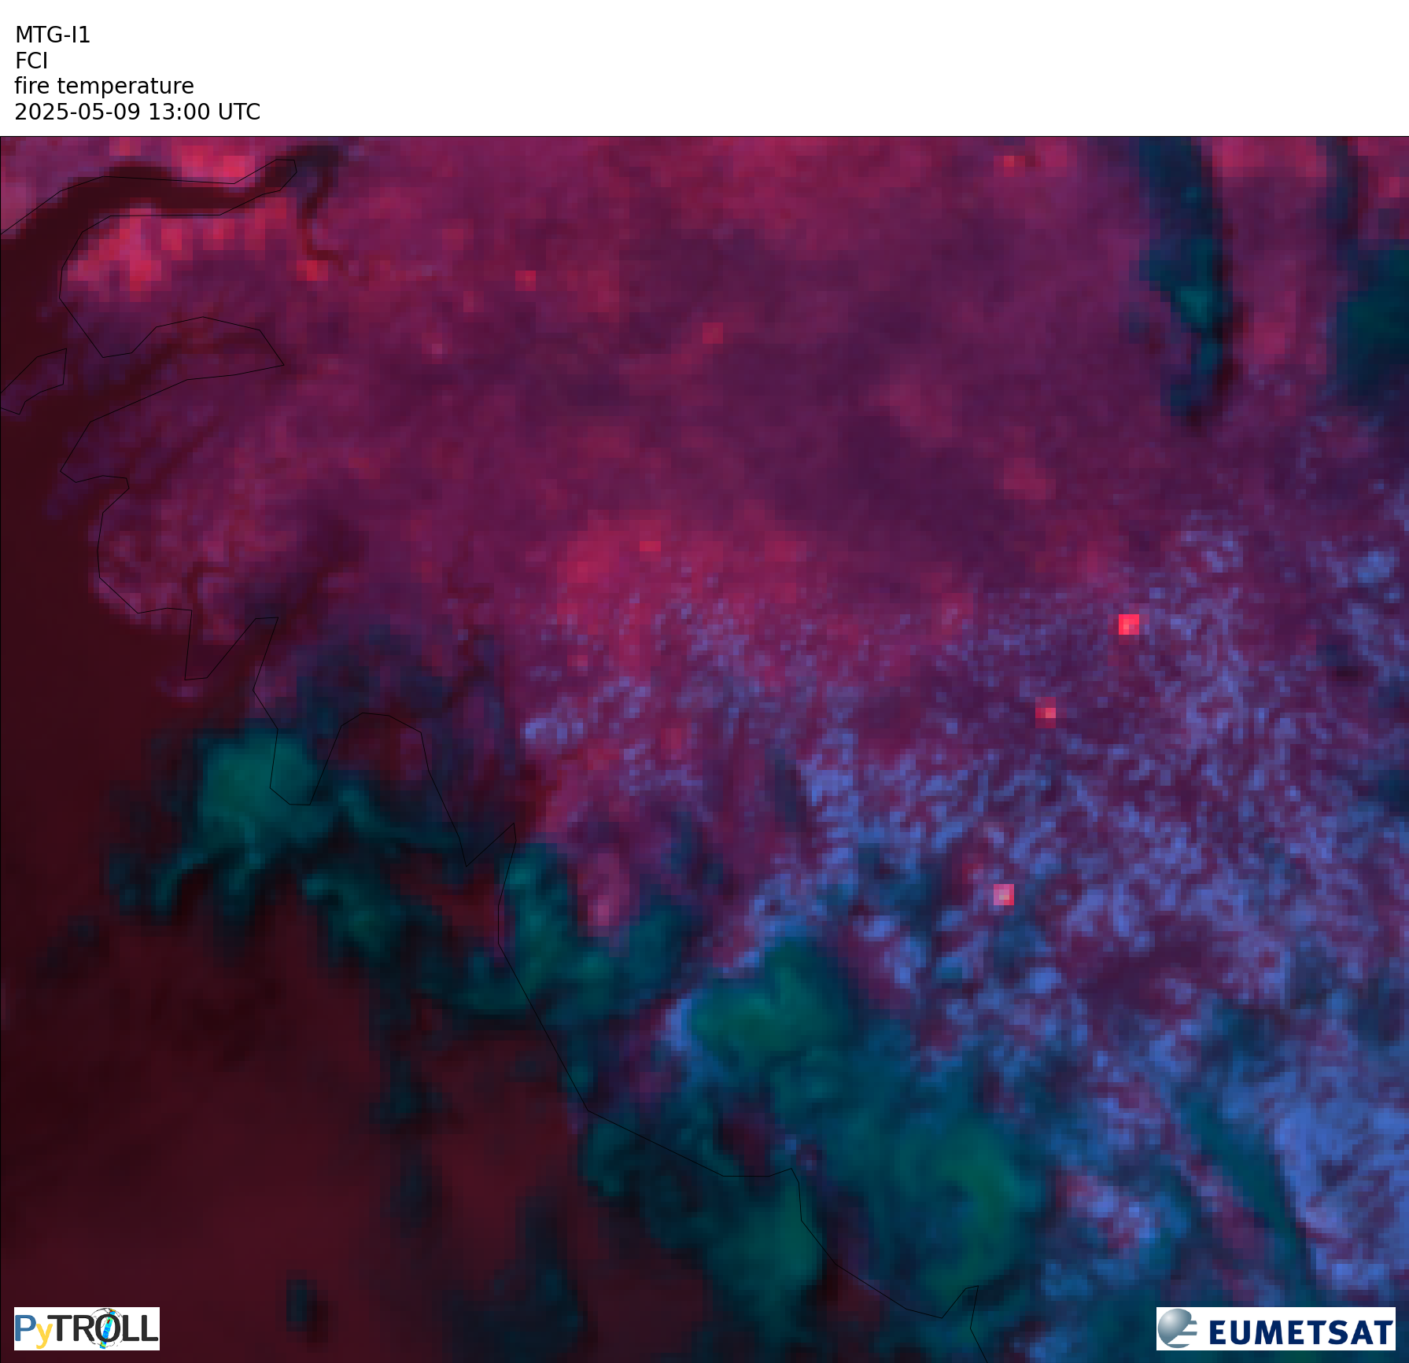
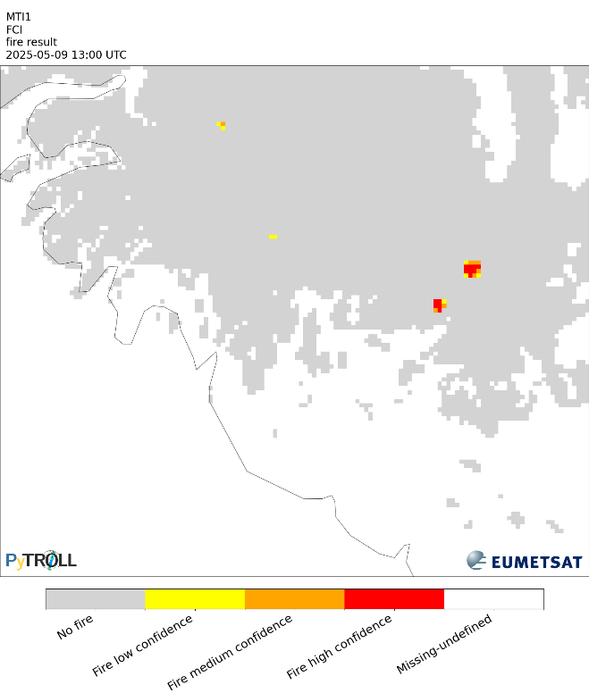
Active Fire Monitoring (FIR)
Detection of hotspots with per-pixel fire probability and fire confidence classes
Based on the heritage SEVIRI algorithm
Bayesian probability computation based on spectral tests on IR channels using forecast background
Uses FCI FDHSI data: IR3.8 and IR10.5 data at 2 km resolution
Fire probability
L1C Fire Temperature RGB
Fire classification
Spatial resolution | Periodicity | File format | Access
2×2 km² (at nadir) | 10 min | NetCDF, CAP | EUMETCast, Data Store

Slide 17
FIR Current Status and Way Forward
First tuning has been performed in Spring 2025 and will continue over the summer
Preliminary validation has been performed over a limited dataset acquired in May over Africa, with MODIS fire product as reference
Performance metrics (POD, PRE, F1) are improved compared to SEVIRI FIR product
Issue with false alarms in first hours of the day in North-East disk area has been identified
Further false alarm sources and missed detection will be addressed in upcoming tuning exercises over the summer
FIR released to member state NHMSs with demonstrational status on June 17, 2025. Release to all users on July 3, 2025
Demonstrational status intended for user familiarization and early feedback phase
Upgrade to Pre-Operational/Operational status during/after the summer to allow resolution of issues, fine-tuning and validation during the fire season in the European Area
Day-2 foremost evolution will be the usage of the 1km IR channels (HR/HRFI data)

Slide 18
Products tailored for NWP Assimilation

Slide 19
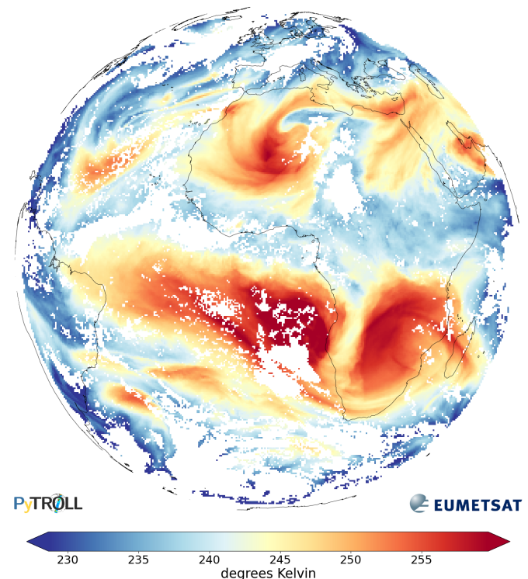
All-Sky Radiances (ASR)
Statistics of L1C radiances, reflectances and brightness temperature within 32x32 km² processing segments
Derived for six scene categories:
All
Clear-sky
Cloudy-sky
Cloudy-sky - low-level clouds
Cloudy-sky – mid-level clouds
Cloudy-sky - high-level clouds
Released with pre-operational status in December 2024
ASR-clear for WV6.3 channel
Spatial resolution | Periodicity | File format | Access
32×32 km² (at nadir) | 10 min | NetCDF, BUFR | EUMETCast, GTS, Data Store

Slide 20
ASR Upcoming improvements in the pipeline
Several improvements expected over the next 1-2 months:
Satellite and solar zenith angles are currently being added to the NetCDF and BUFR files following early user feedback
Further optimization and fine tuning of cloud mask for improved separation of clear and cloudy skies
Further optimization of cloud type classification and height retrieval for improved separation of cloudy scenes by height (low, mid, high)
The L2 ASR product is just statistics of L1C data within processing segments → The accuracy of the product directly linked to the quality of the L1C data
Target is to make ASR ready for operational status in 2025/Q3.

Slide 21
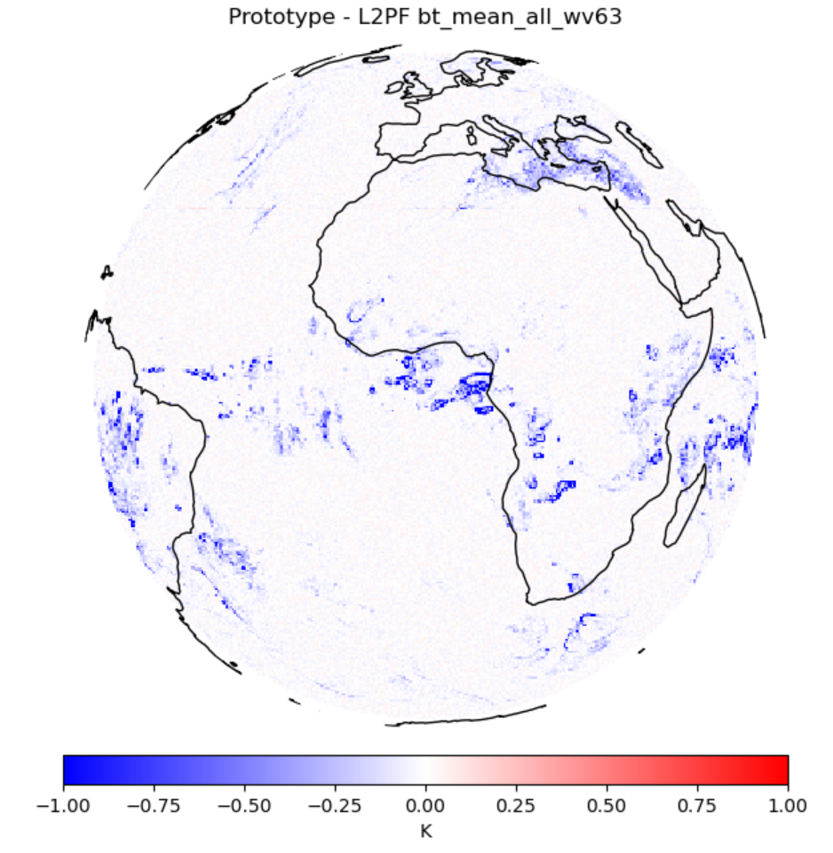
ASR Differences wrt. MSG-SEVIRI
Although the FCI ASR product provides continuity wrt. the SEVIRI L2 ASR product and shows very high correlation with SEVIRI ASR, there are two minor differences in the implementation that may be relevant for users:
1. Computation of segment mean value for brightness temperatures (BTs):
SEVIRI: computed from the pixel-level BTs
FCI: computed from segments mean radiance using Planck formula
For ASR-clear (warm scenes) this makes no difference, but when including cloudy pixels in e.g. ASR-all we see differences of up to ~1K for the coldest scenes where the non-linearity of Planck function increases.
SEVIRI approach – FCI approach
ASR-all, WV6.3
The fact that we derive the average BT from the average radiance in for FCI leads to higher average BTs for cold clouds

Slide 22
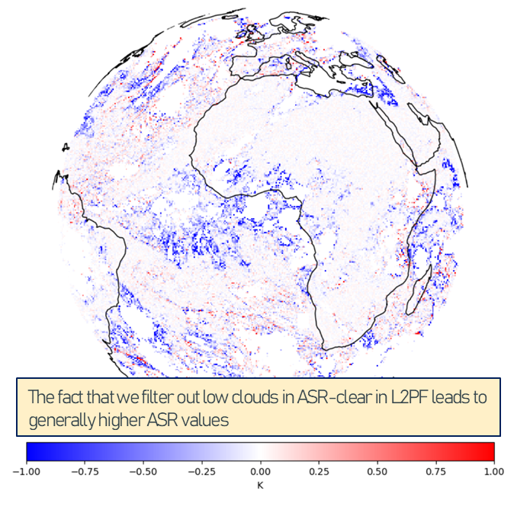
ASR Differences wrt. MSG-SEVIRI
2. Filtering of low clouds for ASR WV6.3
SEVIRI: For the WV6.3 channel also pixels with low clouds are used for the ASR-clear category
FCI: No cloudy pixels, regardless of channel and cloud type/height, are used for the ASR-clear category. Leads to differences of up to approx. 1K
SEVIRI approach – FCI approach
ASR-clear, WV6.3

Slide 23
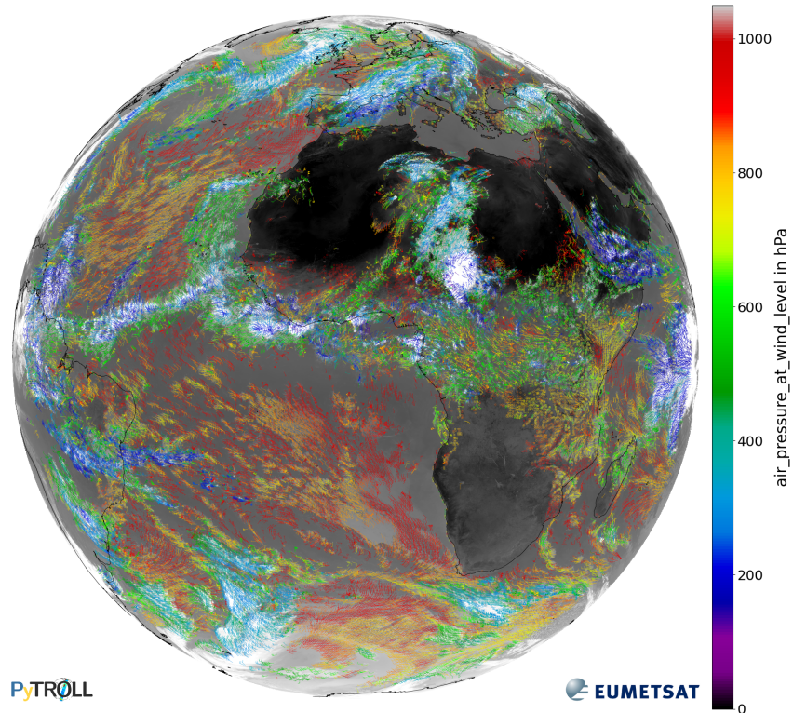
Atmospheric Motion Vector (AMV)
AMVs for IR10.5 channel
Retrieval of atmospheric motion vectors (speed and direction) via cross-correlation and tracking across three repeat cycles
Clear-sky and cloudy-sky targets for VIS0.8, IR3.8 (night only), WV6.3, WV7.3 and IR10.5 channels
FCI L2 OCA cloud top pressure retrieval used for AMV height assignments for cloudy targets
Mainly developed for NWP assimilation but may be used for nowcasting as well.
Released with demonstrational status in December 2024. Upgraded to pre-operational status on June 17, 2025 following several improvements deployed on April 10 and subsequent validation:
Improved processing stability
Bugfix for quality index computation
Improved CLM cloud detection and OCA height retrieval
Target is to release the AMV product with operational status in 2025/Q4 following operational release of CLM and OCA
Despite pre-operational status, ECMWF are assimilating the FCI AMV data operationally as of June 16, 2025 → Proof of good quality data.
Spatial resolution | Periodicity | File format | Access
N/A, tracking applied on 16x16 box pixel boxes | 30 min | NetCDF, BUFR | EUMETCast, GTS, Data Store

Slide 24
AMV Number of winds
Number of winds per product averaged over 10 days in early May 2025
Channel | MSG-SEVIRI | MTG-FCI | Increment Factor
Total | 73 743 | 480 722 | 6.5
VIS0.8 (day only) | 13 772 | 217 440 | 15.8
IR10.8/10.5 | 12 840 | 56 219 | 4.4
WV6.2/6.3 | 14 421 | 78 374 | 5.4
WV7.3/7.3 | 14 975 | 78 173 | 5.2
HRVIS (day only) | 17 735 | N/A | N/A
IR3.8 (night only) | N/A | 50 516 | New
No AMV quality index filtering

Slide 25
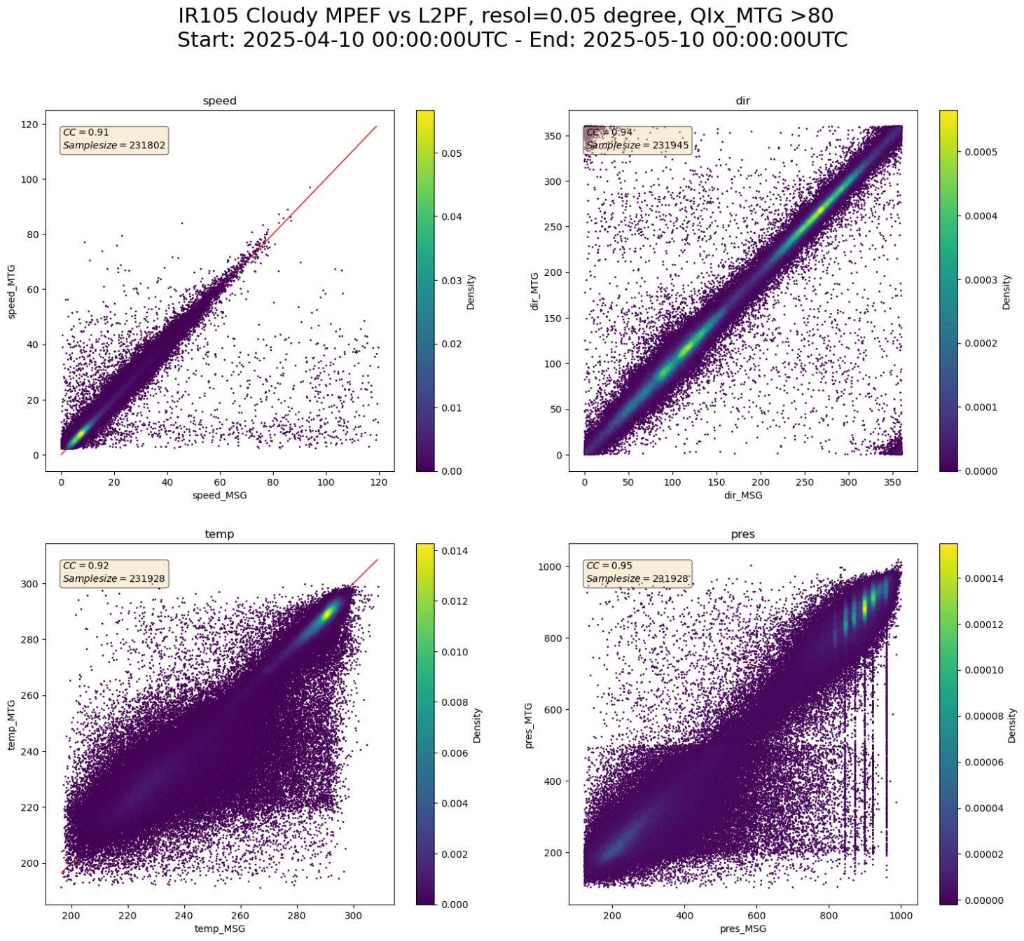
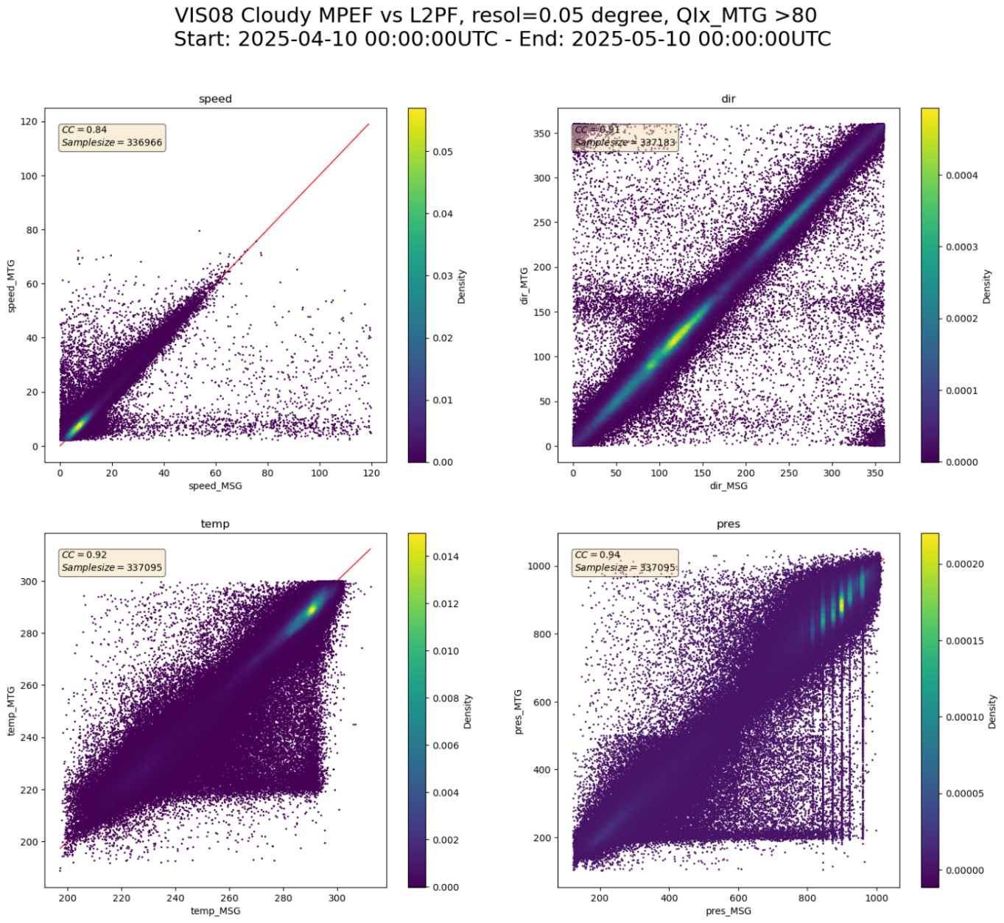
AMV Validation against MSG-SEVIRI AMVs
IR10.5
VIS0.8
Notes:
MSG x-axis and MTG y-axis.
I represent the speed, direction, temperature and pressure.
This is done by griding the 2 AMVs product to a regular lat/lon grid of 0.05 degree.
It take all the concomitant product of the period and aggregate them into these plot.
Only the AMVS with a Qix above 80 are shown here.
OCA HA on MTG better lo level correction yet anomaly in the higher par of the atmosphere (known issue currently being fixed)
CLA on MSG

Slide 26
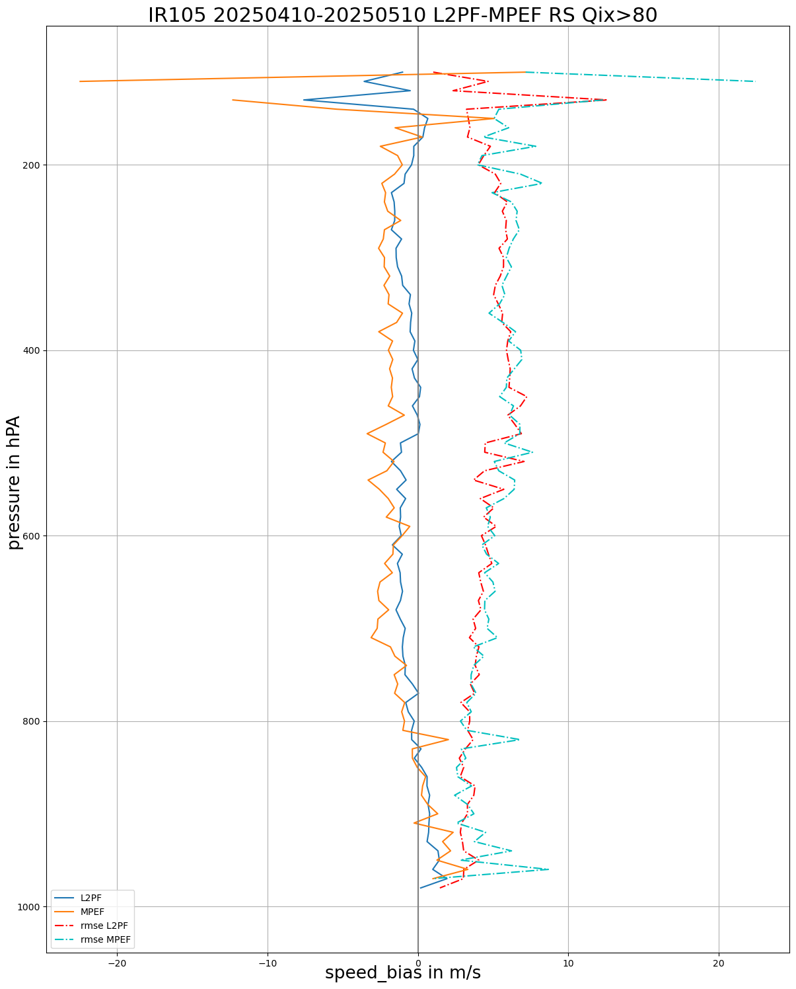
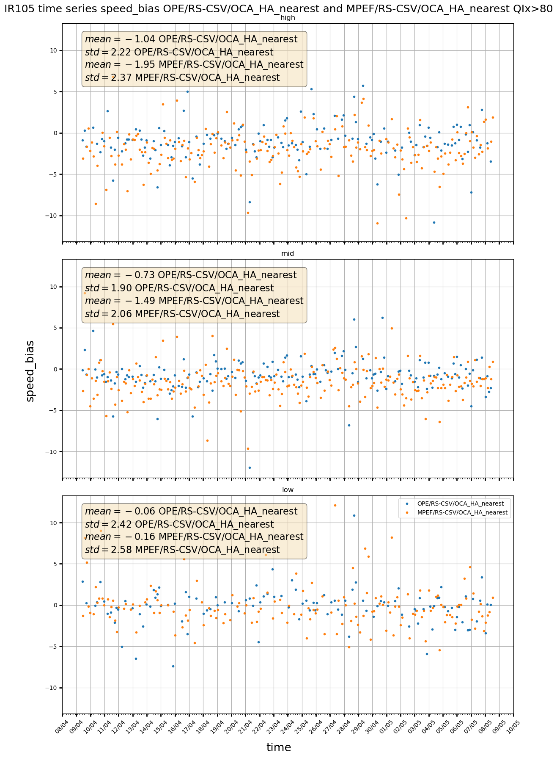

AMV Validation against Radiosondes
MTG-FCI IR10.5 vs. MSG-SEVIRI IR10.8

Slide 27
Additional Products

Slide 28
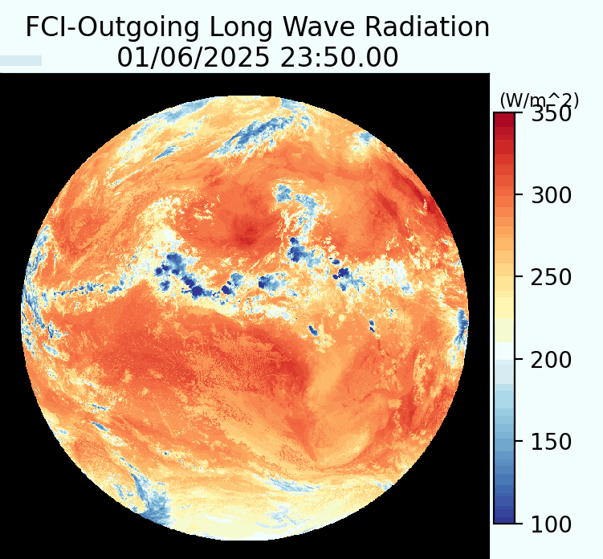
Outgoing Longwave Radiation (OLR)
Calculates the outgoing longwave radiation from the spectral broadband radiances with a linear regression approach
Regression coefficients used to compute OLR depend on cloud type
Takes into account the effect of the viewing angle with limb-darkening functions
Released with pre-operational status in December 2024.Target is to release OLR with operational status in 2025/Q3 following operational quality of the cloud mask
Spatial resolution | Periodicity | File format | Access
2×2 km² (at nadir) | 10 min | NetCDF | EUMETCast, Data Store

Slide 29
Product Release Plan

Slide 30
FCI L2 product release plan
Product | Demonstrational | Pre-Operational | Operational
CLM | N/A | December 2024 | 2025/Q3
OCA | N/A | December 2024 | 2025/Q3
ASR | N/A | December 2024 | 2025/Q3
AMV | December 2024 | June 2025 | 2025/Q4
GII | N/A | December 2024 | 2025/Q3
OLR | N/A | December 2024 | 2025/Q3
CRM | N/A | June 2025 | 2025/Q3
FIR | June 2025 | 2025/Q3 | 2025/Q4
CT | TBD | 2025/Q3 | 2025/Q4
CTTH | TBD | 2025/Q3 | 2025/Q4
This is the current best estimate of the remaining FCI L2 product release. Deviations/delays are possible

Slide 31
Ongoing, planned and potential Day-2 Developments

Slide 32
Ongoing, planned and potential Day-2 developments
There are several activities planned for Day-2
Add detection of snow/ice, dust and ash to the cloud mask and cloud type products
Implement dust and ash retrieval in OCA
Make use of new FCI channels (e.g. NIR1.3 and NIR2.2) for e.g. improved cirrus/snow/aerosol detection, cloud property retrievals, fire detection etc.
Improve OCA two-layer detection and retrieval with new forward model
Make use of high resolution (HRFI) data
Derive cloud detection probability in addition to the current categorial product.
Maintenance and minor code enhancements
Possible changes triggered by user requests
….

Slide 33
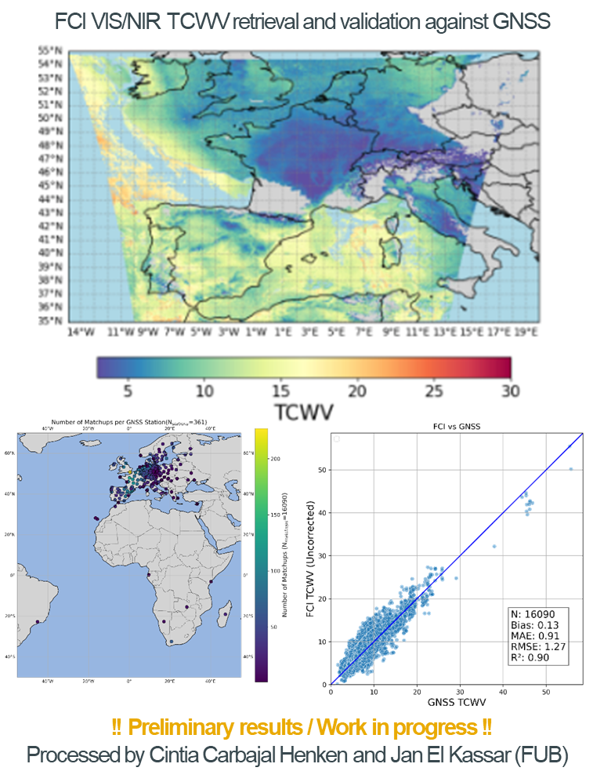
Ongoing, planned and potential Day-2 developments
Scientific development contracts and studies
Contract for multi-mission TCWV retrievals using NIR0.9 channel kicked of in November 2024.
First demonstrational offline FCI processor expected in 2025/Q4. Building on many years of developments for OLCI.
Algorithm framework will be further developed to include thermal IR channels and made applicable to other sensors as well (METImage, OLCI and SLSTR)
Study on Convective Updraught Detection (CUD) in preparation for potential MTG-I RSS L2
Contract for snow detection and snow extent retrieval kicked off in June 2024.
Flood detection based on NOAA/ABI product – kick-off in July 2025.
Ocean colour retrieval, CH4 retrieval for large plumes, aerosol retrieval, …

Slide 34
Summary
Ten FCI L2 products are derived, archived and disseminated to users from the EUMETSAT Central Facility.
Eight products are currently available (seven with pre-operational and one with demonstrational status). Two products are still to be released.
First release of operational products planned for end of 2025/Q3. The rest to follow in 2025/Q4.
Outstanding issues, further improvements and new developments planned as Day-2 activities.
More FCI L2 products will be available through the EUMETSAT Satellite Application Facilities (SAFs)
Example flow-chart of AMV product retrieval
AMV
CLM
OCA

Slide 35
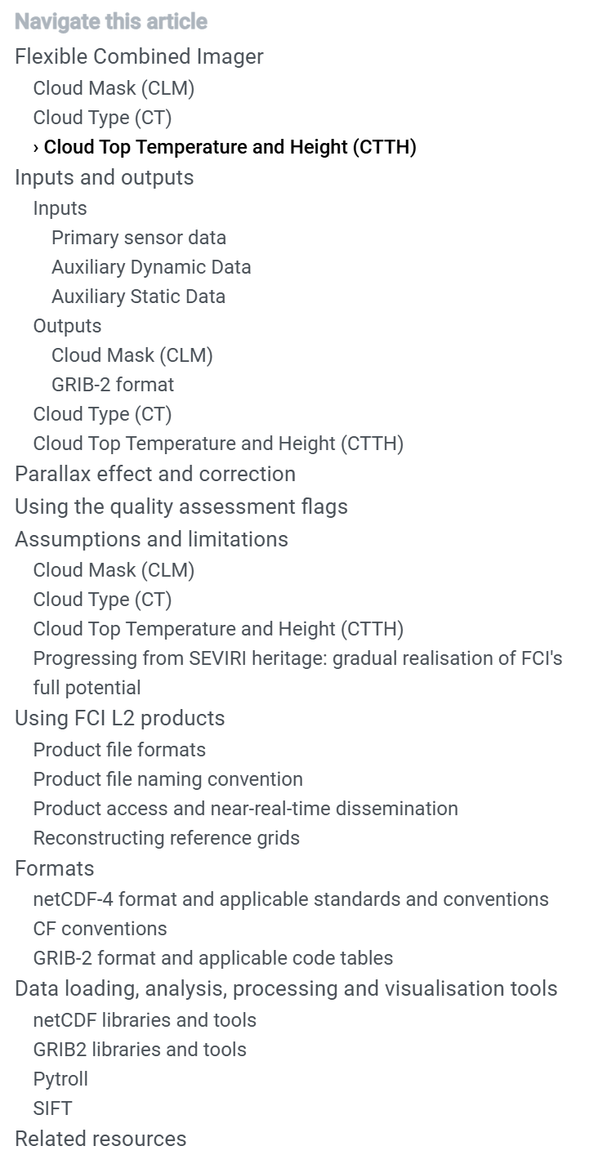
Product User Guides
Further information can be found in the respective online data guides
CLM: https://user.eumetsat.int/resources/user-guides/mtg-fci-l2-clm-and-cla-data-guide
CT: https://user.eumetsat.int/resources/user-guides/mtg-fci-l2-clm-and-cla-data-guide
CTTH: https://user.eumetsat.int/resources/user-guides/mtg-fci-l2-clm-and-cla-data-guide
OCA: https://user.eumetsat.int/resources/user-guides/mtg-fci-l2-oca-data-guide
GII: https://user.eumetsat.int/resources/user-guides/mtg-fci-l2-gii-data-guide
ASR: https://user.eumetsat.int/resources/user-guides/mtg-fci-l2-asr-data-guide
AMV: https://user.eumetsat.int/resources/user-guides/mtg-fci-l2-amv-data-guide
OLR: https://user.eumetsat.int/resources/user-guides/mtg-fci-l2-olr-data-guide
CRM: Coming soon
FIR: Coming soon
Detailed public validation reports to be released once products are declared operational

Slide 36
Thank you!
Questions are welcome.

